Slide 1


SKRIPSI
SIMULASI SELF-DRIVING PADA GAME TRACKMANIA NATION MENGGUNAKAN VISI KOMPUTER
Marselinus Sandimus Jamlu - 215314079
Yogyakarta, 2 JUNI 2025

Slide 2
INTRODUCTION
What is ‘Simulation of Autonomous Driving in Trackmania really is?
Simulate a self-driving system in a game environment.
How does this simulation work?
Computer Vision, Rule-based algorithm

Slide 3
BACKGROUND
Why was self-driving invented?
“Human error causing traffic accidents. Self-driving car intended to minimize this.” Klauer, Guo. 2014
When did the idea originate?
“Started gain its fame since the mid 80’s”
Badue. 2021
Why simulation? And why is it on a game?
Lightweight, Saver, cheaper, more accessible, replayability.

Slide 4
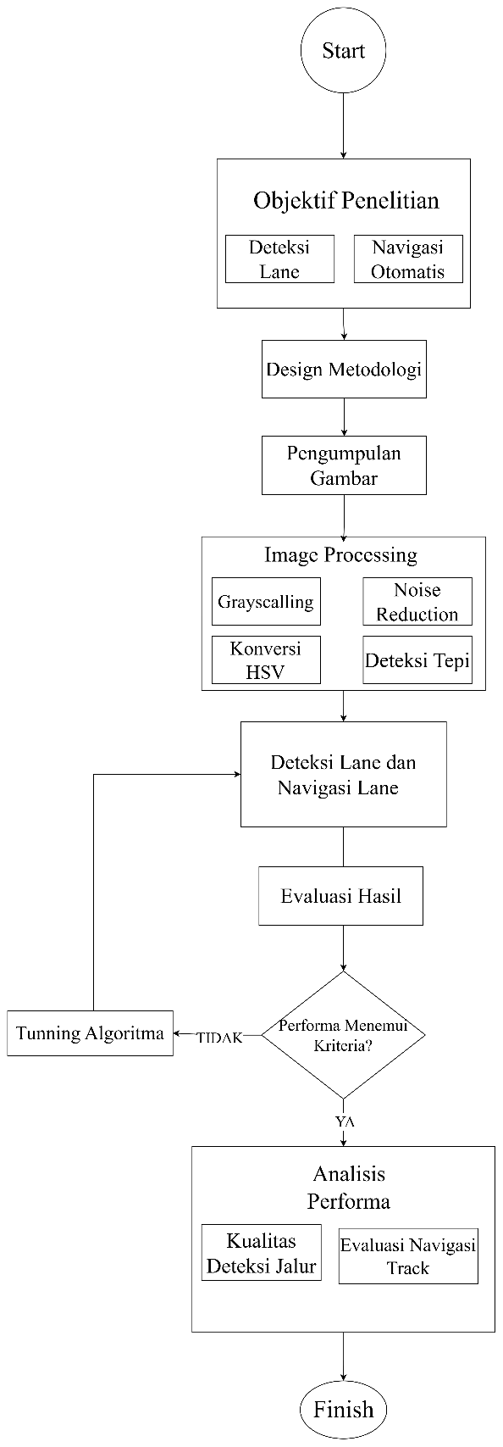
METHODOLOGY
Image Gathering
Image Processing
Lane Detection
Driving Algorithm
Performance Metric
Result and Analysis
Parameter Tunning
Conclusion and Future Work

Slide 5
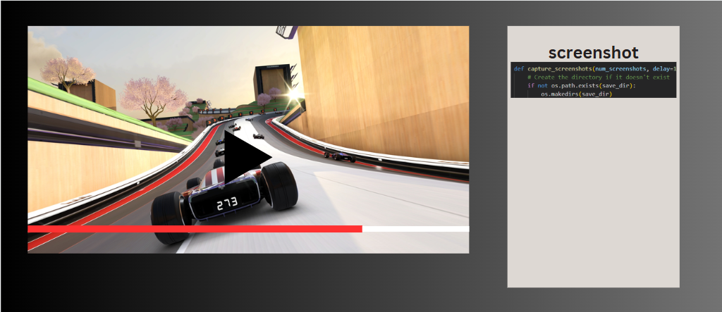
Capture monitor at certain coordinates.
Add delays to prevent redundancy.
Store each road condition in separate folders.
Is used For debugging purposes
IMAGE GATHERING

Slide 6
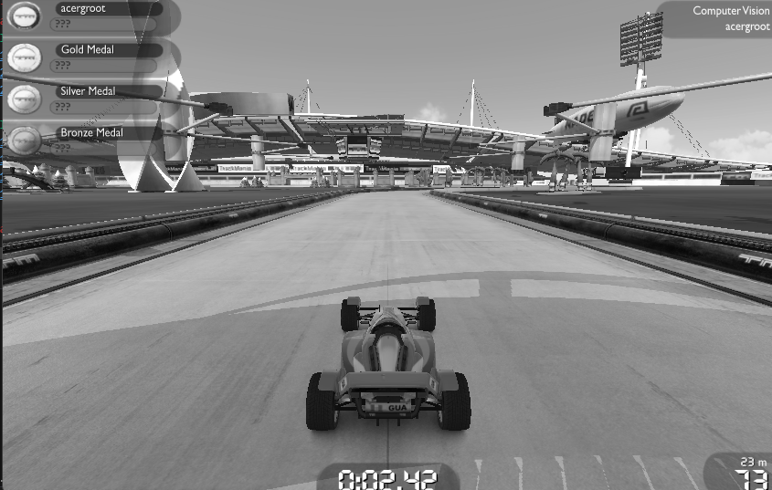
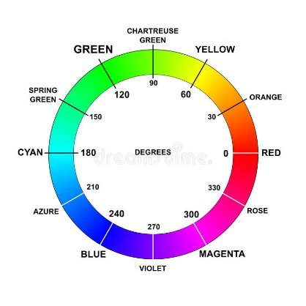
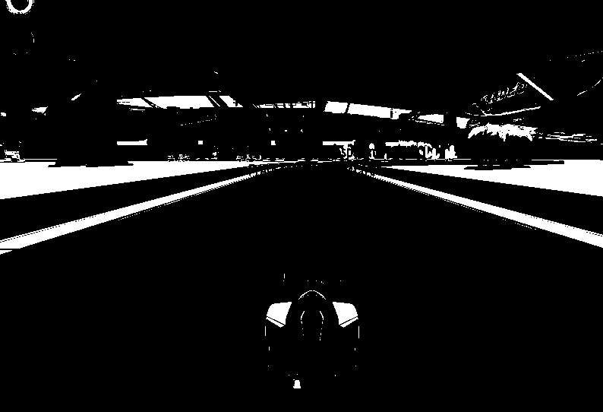
Grayscalling
HSV
Blurring
Edge Detection
Single channel color spaces (0-255) reducing computational processing
Isolate certain color for better edge detection.
Balancing pixel distributions and reducing noise.
Finding the sharp pixel intensity change.
IMAGE PROCESSING

Slide 7
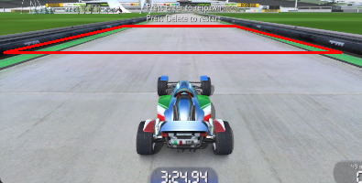
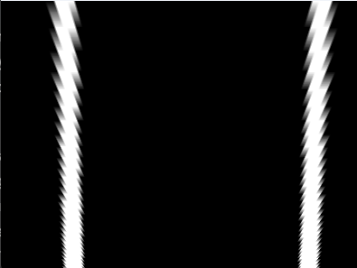
ROI
Perspective Warping
Isolate specific region on the image.
Warp road perspective to give a sense of bird’s eye view.
IMAGE PROCESSING

Slide 8
Find the lane and drive the car along the detected lane.
THEN WHAT?

Slide 9
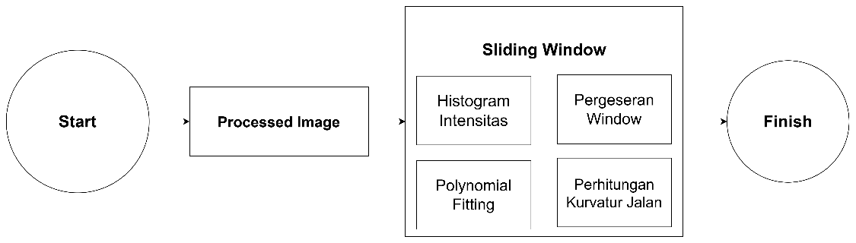
Good for curves and trajectory
Handling noise better
Complex but robust (CS rule of thumb)
SLIDING WINDOW

Slide 10
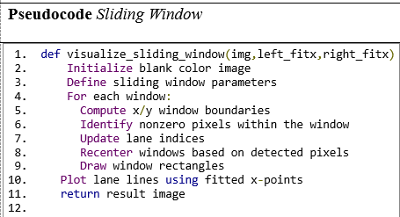
Window Initialization
Search for non-zero pixels (white pixels)
Re-Centering Window
Combine Index indices (for left and right road pixels)
Polynomial Fitting
Left Non-zero (255)
Right Non-zero (255)
WINDOW INITIALIZATION

Slide 11
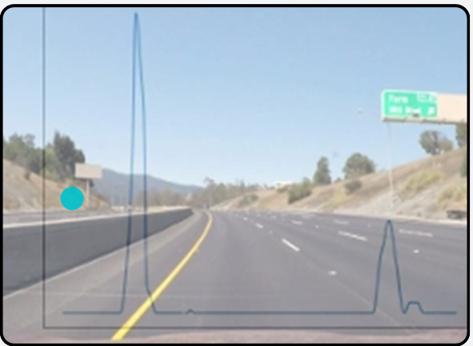
Find the non-zero pixel along the x axis:
if found:
set the window for both left and right
else:
move along the y, find the non-zero pixel on the x axis with the new y
First Window
HISTOGRAM INTENSITY

Slide 12
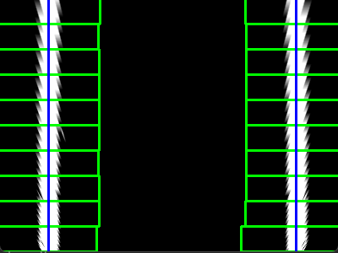
y
For each window ( i from 0 to n_window):
place window at current position:
if non-zero pixels are found in the window:
center the next window at the mean x position of these non-zero pixels
else:
if i >0:
center the next window at the mean x
else:
keep the current position for the next window
Placed next window based on mean of prev. window
Use previous x coordinates
Calculate mean on x axis
x
SLIDING

Slide 13
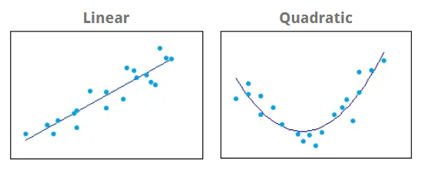

Second quadratic polynomial
For each window ( i from 0 to n_window):
extract non-zero position for left lane (left_X, left_Y)
extract non-zero position for right lane (right _X, right_Y)
fit left and right lane to polynomial function (polyfit(left_Y, left_X, 2)
return the left and right fit value
$x= {ay}^{2}+by+c$
Plot the detected lane based on polynomial function.
FITTING POLYNOMIAL
Notes:
In a polynomial equation, the y-intercept is the value of the polynomial when the input variable is zero.
For a 2nd-degree polynomial (quadratic) of the form:
y = a*x^2 + b*x + c
the y-intercept is the value of y when x = 0, which is simply c.
In the context of lane detection, if your polynomial is:
x = a*y^2 + b*y + c
then the x-intercept at y = 0 is c. This means the polynomial crosses the x-axis at the point (c, 0).
Summary:
The y-intercept is the constant term (c) in the polynomial.
It represents where the curve crosses the y-axis (or x-axis, depending on variable arrangement).

Slide 14
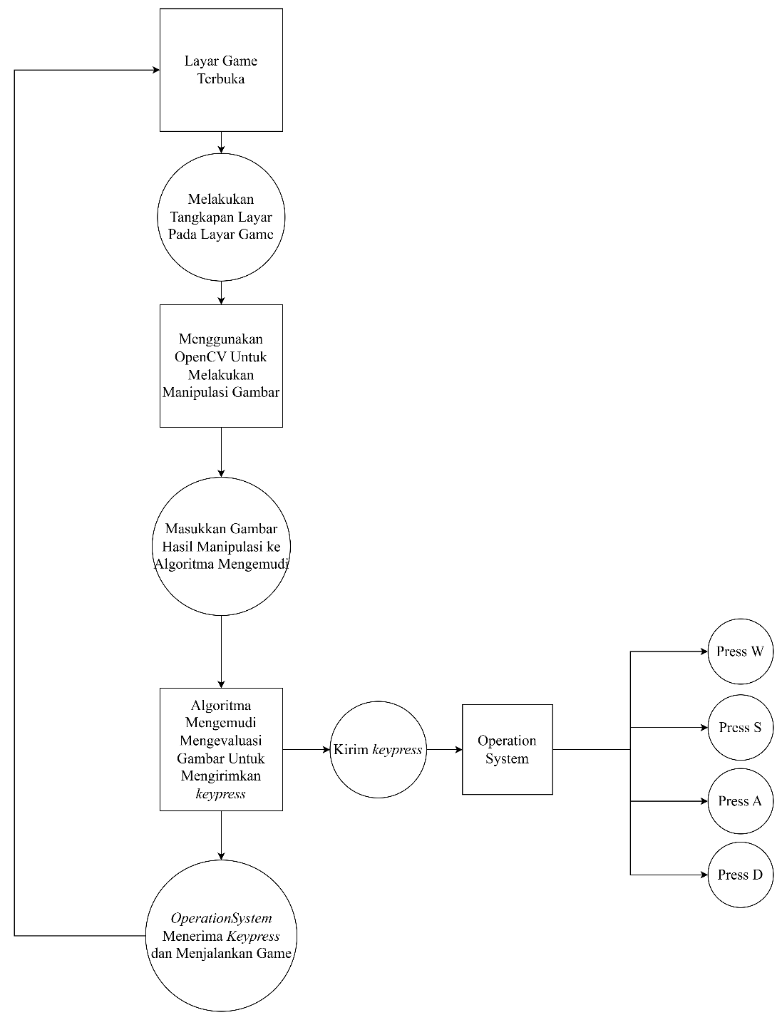
The driving algorithm uses the car’s position and the road’s curve to calculate how much to steer and how fast to go, always trying to keep the car centered.
DRIVING ALGORITHM

Slide 15

CURVATURE
Polynomial Fitting
$x= {ay}^{2}+by+c$

Slide 16
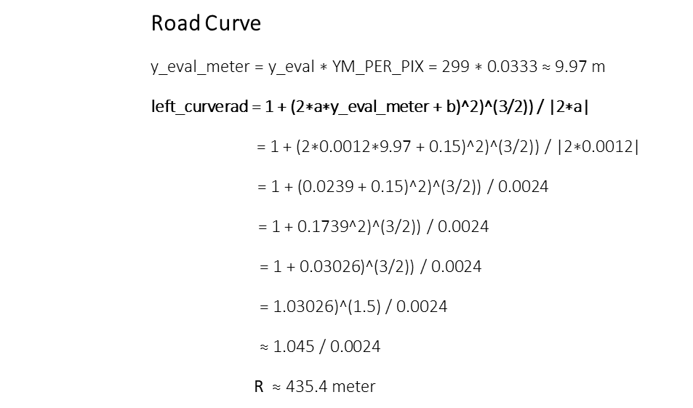

EXAMPLE
Left side road Polynomial
Road Curve
$$\text{y}\text{_}\text{eval}\text{_}\text{meter}\text{ = }\text{y}\text{_}\text{eval}\text{ ∗ }\text{YM}\text{_}\text{PER}\text{_}\text{PIX}\text{ = 299 ∗ 0.0333 ≈ 9.97 }\text{m}$$
$$\text{left}\text{_}\text{curverad}\text{ = 1 + (2∗}\text{a}\text{∗}\text{y}\text{_}\text{eval}\text{_}\text{meter}\text{ + }\text{b}\text{)^2)^(3/2)) / |2∗}\text{a}\text{| }$$
$$\text{= 1 + (2∗0.0012∗9.97 + 0.15)^2)^(3/2)) / |2∗0.0012|}$$
$$\text{= 1 + (0.0239 + 0.15)^2)^(3/2)) / 0.0024}$$
$\text{= 1 + 0.1739^2)^(3/2)) / 0.0024}$
$\text{ = 1 + 0.03026)^(3/2)) / 0.0024}$
$$\text{= 1.03026)^(1.5) / 0.0024}$$
$$\text{≈}\text{ 1.045 / 0.002}\text{4}$$
R $\text{≈ 435.4 }\text{meter}$
a = 0.0012
b = 0.15
y_eval = 299
YM_PER_PIX = 10/300 = 0.0333 m/piksel
XM_PER_PIX = 2/400 = 0.005 m/piksel
$$R=\frac{{\left(1+{\left(2ay+b\right)}^{2}\right)}^{3/2}}{\left|2a\right|}$$

Slide 17
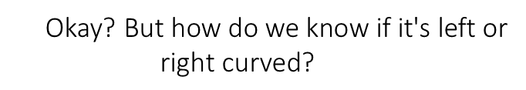

LEFT, OR RIGHT ?
$\text{435.4 }\text{meter}\text{s}\text{ ?}$
Okay? $\text{But} \text{how} \text{do} \text{we} \text{know} \text{if} \text{it}\text{′}\text{s} \text{left} \text{or} \text{right} \text{curved}\text{?}$

Slide 18
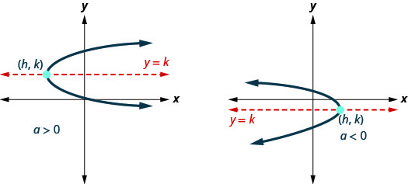
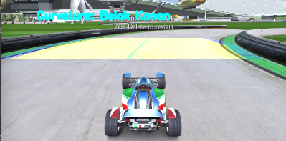
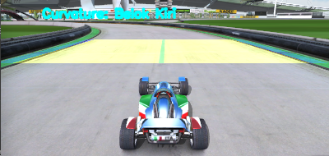
SO, 2 * left_fit[0] = 0.0024 (right curve)
The curvature direction is determined by the second derivative of these equation respect to y
If 2 * left_fit[0] > 0 (positive value), the parabola opens to the right (curves right)
if 2 * left_fit[0] < 0 (negative value), the parabola opens to the left (curves left)
If 2 * right_fit[0] > 0 (positive value), the parabola opens to the right (curves right)
If 2 * right_fit[0] < 0 (negative value), the parabola opens to the left (curves left)

Slide 19
OFFSET
How far the car is from the center of the lane ?
center_offset_px = car_location - center_lane

Slide 20
EXAMPLE
Car position along the x axis: x = 700, x = 100
Car position : (700 + 100 ) = 400
Lane Center : (bottom_right + bottom_left) / 2 = (e.g.) 380
Offset: 400 – 380 = 20 pixel
Offset Conversion: 20 x 0.005 x 100 = 10 cm (off to the right)

Slide 21
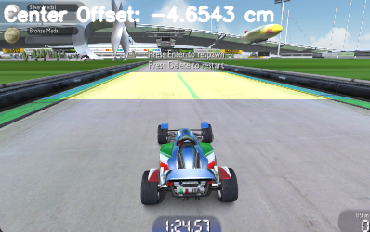
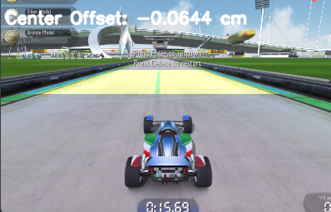
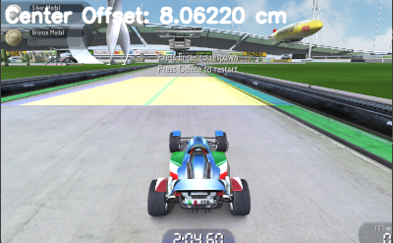
O
F
F
S
E
T

Slide 22
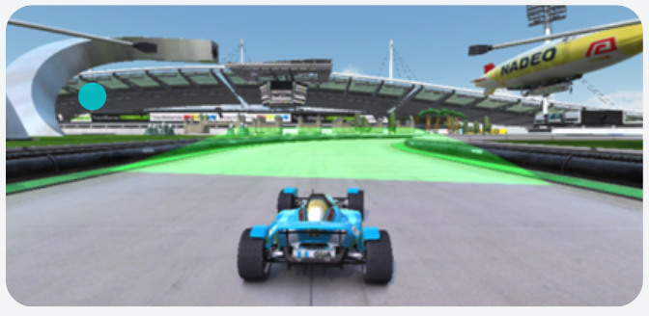
PUT EVERYTHING TOGETHER
Method process_frames_loop():
While is_running:
Get frame from frame_queue
Process frame with LaneDetector to get:
- center_offset
- curve_radius
- visualization image
Put results into result_queue
Method control_loop():
While is_running:
Get results from result_queue
Calculate steering_value based on center_offset and curve_radius
Calculate speed_value based on curve_radius and offset
Apply controls (steering and speed) using keyboard input
Method apply_controls(steering_value, speed_value):
If steering_value indicates left:
Press left key briefly
Else if steering_value indicates right:
Press right key briefly
Else:
Release steering keys
If speed_value is high:
Press forward key
Else if lane lost:
Press brake key
Send frames
Control Commands

Slide 23
Off-Center
Approaching the curves (curve_rad < 500)
The steering value is proportional to the center offset. Meaning, if the car is left of center, steer right (and vice versa).
If the car is almost centered, reduce steering to avoid overcorrection.
If the road is sharply curved (small curve radius), add extra steering in the curve’s direction and reduce speed further.
DRIVING RULES

Slide 24
Base Speed
Lane Detection Failed
Start with a base speed value. The car keep moving (with pulse) forward until certain condition meets.
If the system has failed to detect the lane several times, reduce speed.
DRIVING RULES
DRIVING RULES

Slide 25
Let’s talk about performance, baby.
What are the metrics?
What caused the bottlenecks?
DRIVING RULES
SIMULATION PERFORMANCE

Slide 26

LANE DETECTION ACCURACY
Track | Mean IoU (%)
1 | 0.846
2 | 0.799
3 | 0.783
4 | 0.732
5 | 0.808
6 | 0.809
7 | 0.704
8 | 0.796
9 | 0.711
10 | 0.732
mean | 0.770
Calculate how accurate the lane detection algorithm is.
A reliable lane detection actively impacting the driving algorithm pipeline.
By Calculating the IOU, we’ll get the estimation how close the detected lane compared to the actual lane.
$IoU=\frac{\left|A∩B\right|}{|A ∪ B|}$
PERFORMANCE METRIC

Slide 27
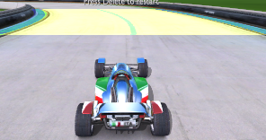
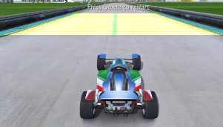
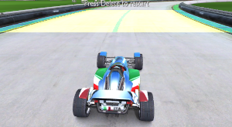
LANE DETECTION CONSISTENCY (a qualitative measurement)
Does it consistent?
Lane detection consistently followed the road morphology. The hiccups will be explained later.
PERFORMANCE METRIC

Slide 28
TRACK COVERAGE
Track | Panjang Track (m) | Jarak Tempuh Sebelum Menabrak (m) | Persentase Keberhasilan (%)
1 | 538 | 230 | 42.75
2 | 575 | 300 | 52.17
3 | 405 | 205 | 50.61
4 | 413 | 413 | 100.0
5 | 357 | 185 | 51.82
6 | 457 | 145 | 31.72
7 | 403 | 340 | 84.36
8 | 351 | 177 | 50.42
9 | 257 | 166 | 64.59
10 | 355 | 195 | 54.92
Rata-Rata Keberhasilan |  |  | 55.56
High coverage with less complex road, low otherwise.
PERFORMANCE METRIC

Slide 29
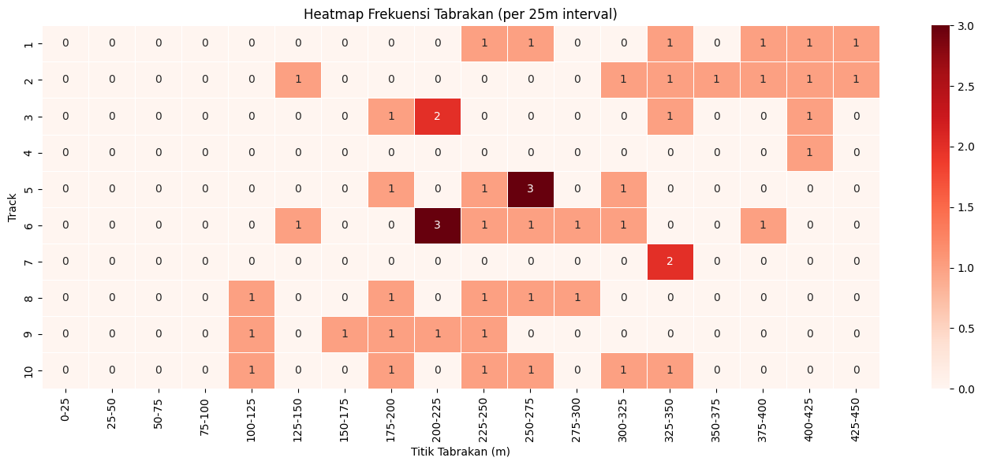
DRIVING PERFORMANCE HEATMAP
Struggling with highly complex road conditions.
PERFORMANCE METRIC

Slide 30
Detection Time
Driving
Fungsi | Panggilan (per profiling) | Waktu per Panggilan (s) | Total Waktu (s)
overlay_lane_lines | 213 | 0.003 | 0.666
get_lane_line_indices_sliding_windows | 213 | 0.002 | 0.467
warpPerspective | 426 | 0.001 | 0.240
Total Waktu Eksekusi (s) |  |  | 1.373
Fungsi | Panggilan (per profiling) | Waktu Per Panggilan (detik) | Total Waktu (detik)
apply_controls | 158 | 0.202 | 31.885
pydirectinput.wrapper | 316 | 0.101 | 31.854
pydirectinput._handlePause | 316 | 0.100 | 31.706
cv2.waitKey | 166 | 0.013 | 2.101
PERFORMANCE METRIC

Slide 31
Detection Error
Driving Error
Will fail on different color (other than green) track.
Failed to detect in high speed due to perspective shifting.
Approaching the road edges caused the ROI misaligned.
Struggle on sharp curves.
No error handling when another object appears.
Keyboard controller nature (on and off binary)
No feedback when crash happens
Lack of prediction based on history.
Pulsing method causing high latency with the control.
Will struggle (error even) with highly complex road.
CHALLENGES

Slide 32
Is there any way to make the code run faster?
OPTIMIZATION

Slide 33
The producer (Capturing) and consumer (detection) run independently.
They communicate via a shared queue (buffer).
The producer adds items to the queue; the consumer removes items from the queue.
If the queue is full, the producer waits. If the queue is empty, the consumer waits.
Wait If queue full
Wait If queue empty
Incoming Frames
Queue Capacity = 3
Producer
Consumer
But Why?
Prevents data loss and race conditions.
Improves efficiency and resource utilization, especially in multi-threaded or multi-process systems.
PARALLEL COMPUTING
Notes:
Why it's not sequential:
Producer and consumer run in parallel (usually as separate threads or processes).
The producer can keep producing new data and putting it in the queue, even while the consumer is still processing previous data.
The consumer can process data as soon as it appears in the queue, without waiting for the producer to finish all its work.
What does "wait" mean here?
"Wait" only happens when the queue is empty (consumer waits) or when the queue is full (producer waits).
Most of the time, both are running independently and in parallel, just at their own speeds.
Example:
If the producer is fast and the consumer is slow, the queue fills up and the producer may pause.
If the consumer is fast and the producer is slow, the consumer may pause waiting for new data.
But as long as both have work, they run at the same time.
In summary:
Sequential: Producer must finish everything before consumer starts.
Producer-consumer: Both can work at the same time, only pausing if the queue is empty/full.

Slide 34
Only calculate x number of frames and skip n’th frames/s
Skip frames
FRAME SKIPPING
Notes:
Since the game runs at 60 fps, we could trim certain frames to minimize the computation load.

Slide 35
Experimenting parameters
PARAMETER TUNNING
Notes:
Since the game runs at 60 fps, we could trim certain frames to minimize the computation load.

Slide 36
ROI
Why not a bigger or smaller ROI?
Bigger ROI captures more road but potentially capturing irrelevance data.
Smaller ROI fit better with the road but prone to error with curves.
PARAMETER TUNNING

Slide 37
FRAME SIZE
Why is the game frame set to 400x300
Reducing the game frame size = smaller data size to process.
PARAMETER TUNNING

Slide 38
CAR SPEED
Why can’t the car run higher at certain threshold?
Perspective shifting makes the road inconsistent.
The simulation isn’t ‘fast’ enough to process that much data.
PARAMETER TUNNING

Slide 39
Driving algorithm optimization
More complex game env.
Neural Network approach
FUTURE RESEARCH

Slide 40
THANK YOU

